Slide 1
Document Verification & Authentication
Presented By:
Vishal Khatal
Komal Kankariya
Namita Sarode
Reshma Shendge
Guided By:
Prof. S.S.Banait

Slide 2
Steganography
STEGANOS
GRAPHIE
covered
writing
The art and science of writing hidden messages in such a way that no one, apart from the sender and intended recipient, suspects the existence of the message

Slide 3
Digital Watermarking
Digital watermarking is the process of embedding information into a digital signal .
Watermark
Original Image
Embedding procedure
Watermarked Image

Slide 4
Types of watermark
Robust Watermark
Fragile Watermark
Visible Watermark
Invisible Watermarking

Slide 5
Existing system
Acquire parameter
- Details of document owner.
Convert
-Computation of row , column , & values.
Hide
-Identification of the pixel in original image.
-Hiding of data.
-Restore the pixel.

Slide 6
Drawbacks
Easy to detect stereographic image.
Sometimes difficult to detect the pixels.
Easy to modify the hidden data.
Doesn’t satisfy security requirement.

Slide 7
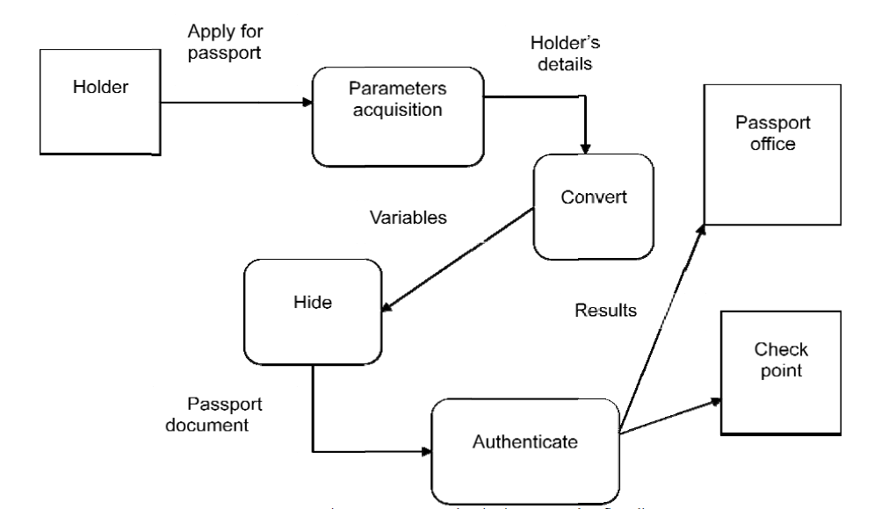
Proposed system

Slide 8
Modules
Registration
Generate Unique Keys and Parameters
Create Image Card and Save to Database
Image Card Viewer
Apply Image Card Verification

Slide 9
LSB Algorithm
Replaces least significant bits with the message to be encoded
Most popular technique when dealing with images
Simple, but susceptible to lossy compression and image manipulation

Slide 10
LSB - Example
A sample raster data for 3 pixels (9 bytes)
may be:
Inserting
the binary
value for
A
(10000001)
changes
3 bits
00100111 11101001 11001000
00100111 11001000 11101001
11001000 00100111 11101011
00100111 11101000 11001000
00100110 1100100 11101000
11001000 00100111 11101011

Slide 11
Benefits
Transparency
Robustness
Security
Capacity
Reversibility
Possibility of verification

Slide 12

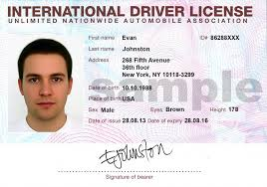
Applications
Owner identification

Slide 13
Conclusion
This authentication scheme embeds the invisible watermark into the photo.
It satisfies
- robustness
- Invisibility
-Undetectability
-Security requirements.

Slide 14
References
[1] AlaaH.Al-Hamami and SaadA.Al-Ani, Faculty of Information Technology, Amman Al-Ahliyya University, Amman, Jordan “A New Approach for
Authentication Technique”Journal of Computer Science 1 (1): 103-106, 2005 ISSN 1549-3636 ©Science Publications, 2005
[2] ManjitThapa, Dr.Sandeep Kumar Sood, A.P Meenakshi Sharma “Digital Image Watermarking Technique Based on Different Attacks”. (IJACSA)
International Journal of Advanced Computer Science and Applications, Vol. 2, No. 4, 2011
[3] Er. Deepak Aggarwal, Er. Kanwalvir Singh Dhindsa “Effect of Embedding Watermark on Compression of the DigitalImages” JOURNAL OF COMPUTING, VOLUME 2, ISSUE 2, FEBRUARY 2010, ISSN 2151-9617

